Slide 1
BIOL792 Presentation
Sage Babish and Victoria Peechatt

Slide 2
Sage’s Study System:

Slide 3
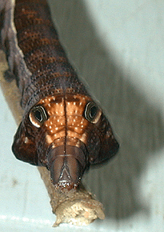
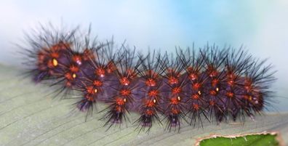
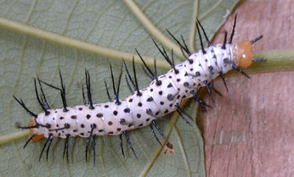
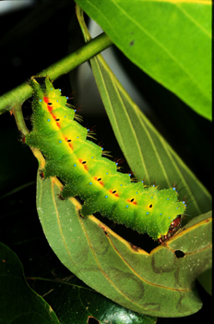
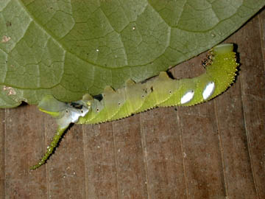
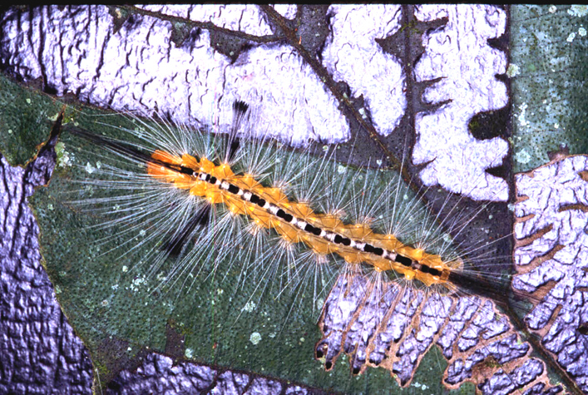
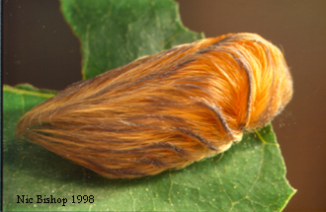
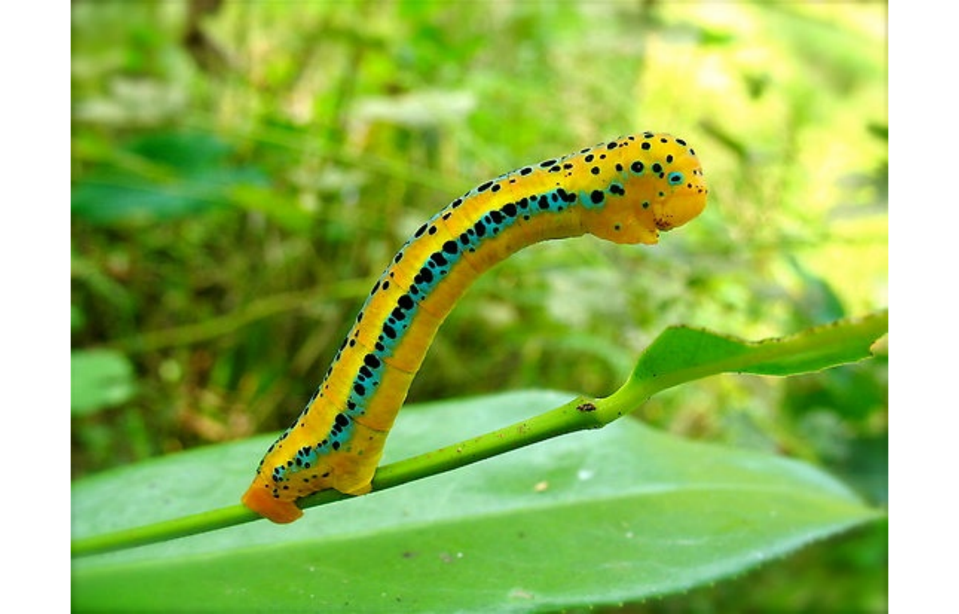
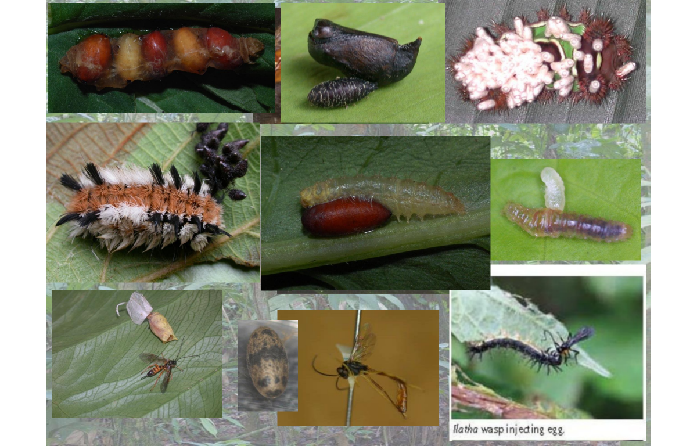
Peechatt’s Study System:
Orange spiracled wooly bear
Heliconius cydno galanthus
Xylophanes pluto
Copaxa curvilinea
Manduca florestan
Hyaleucerea sp. 1
Megalopyge albicollis

Slide 4
“Studies on evolving interactions among species and the coevolutionary process have suggested that the conservation of biodiversity requires a broad geographic perspective, if the `interaction biodiversity' of the earth is to be conserved with its species diversity. Continued maintenance of the geographic mosaic of specialization, defense and population structure appears to be crucial to the coevolutionary process and the long-term persistence of some interspecific interactions.” - Thompson 1996
Thompson JN. Evolutionary ecology and the conservation of biodiversity. Trends Ecol Evol. 1996 Jul;11(7):300-3

